Slide 1
CS 111—Intro to Computational Science
Discussion Section Week 1
Notes:
Who did some coding this summer?

Slide 2
About Me
Steven Munn
sjmunn@cs.ucsb.edu
https://www.cs.ucsb.edu/~sjmunn/

Slide 3
Discussion Section Objectives
Install Anaconda on your computer
Witness the power of matplotlib
Survey debugging tools for Jupyter
Grasp the importance of visualization

Slide 4


What is Anaconda?

Slide 5



What is Anaconda?

Slide 6
The General Hierarchy
Package Manager
Interpreter
Applications/IDEs
Packages

Slide 7
Installing Anaconda Ubuntu 18
Computer demo..

Slide 8
Installing Anaconda Windows 10
Surprisingly easy actually..

Slide 9
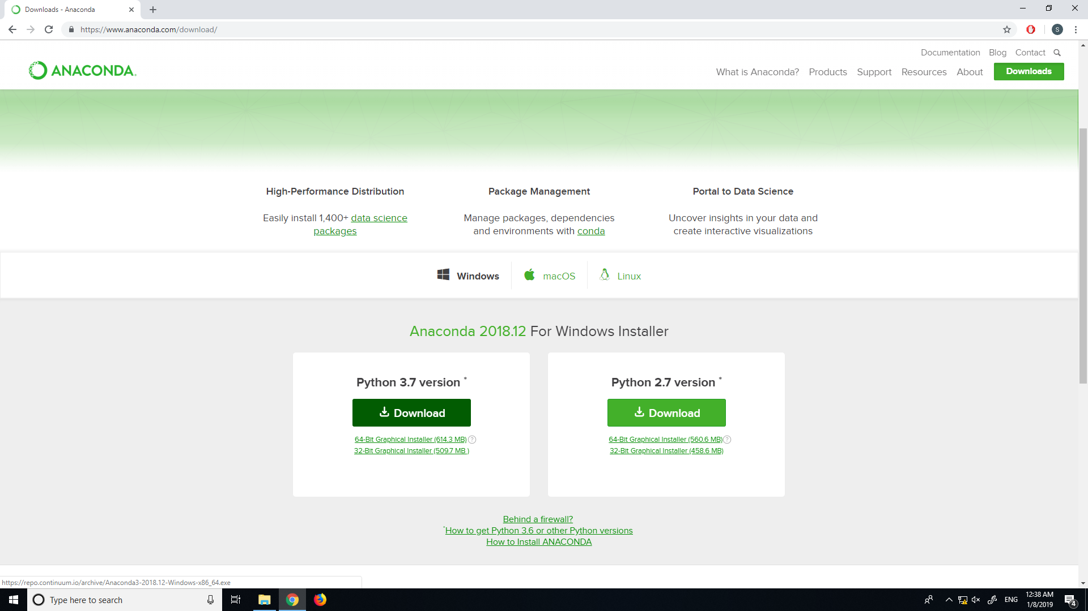
Go to the Anaconda Website
Click here

Slide 10
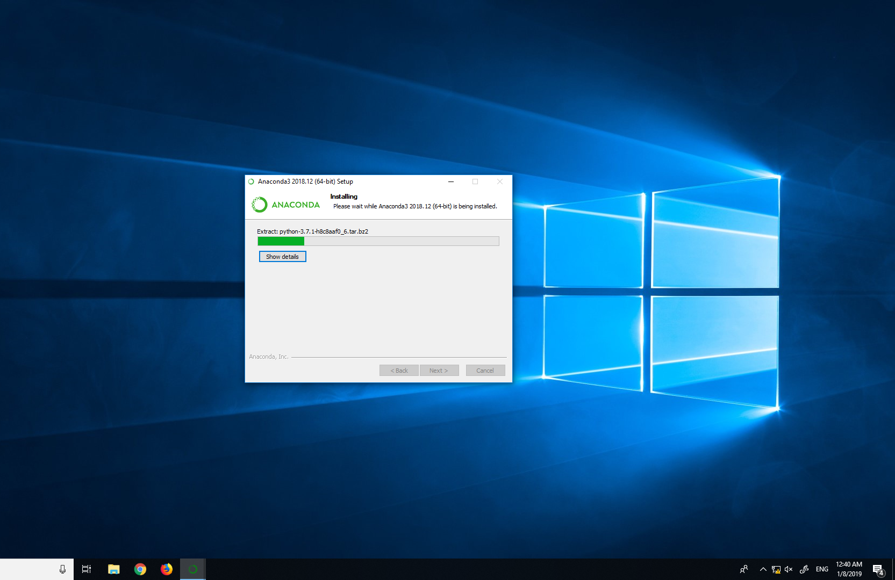
Open the .exe
Mindlessly hit “next” until it is greyed out

Slide 11
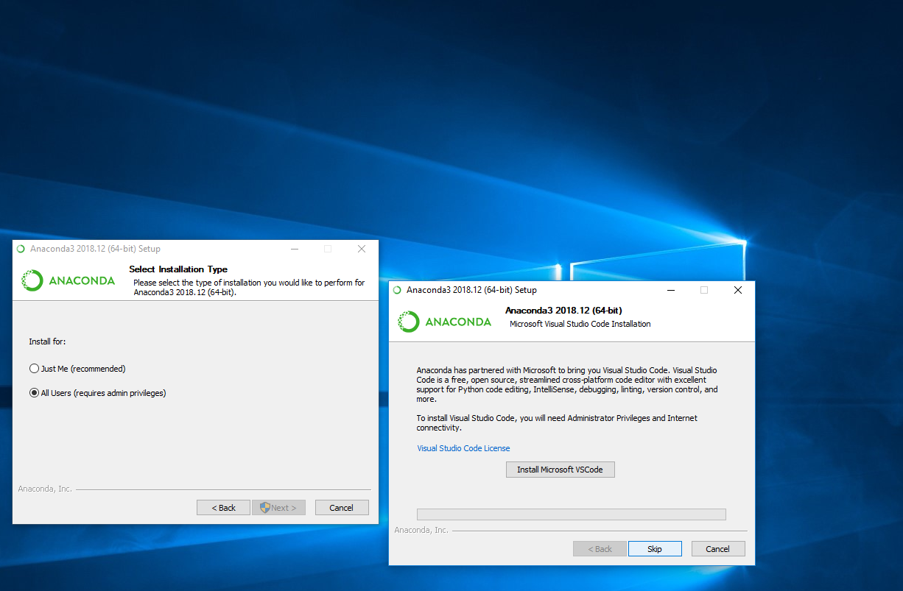
Skip VScode

Slide 12
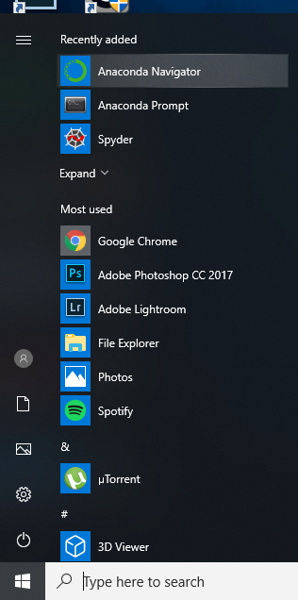
Find the Anaconda Navigator
Click here

Slide 13
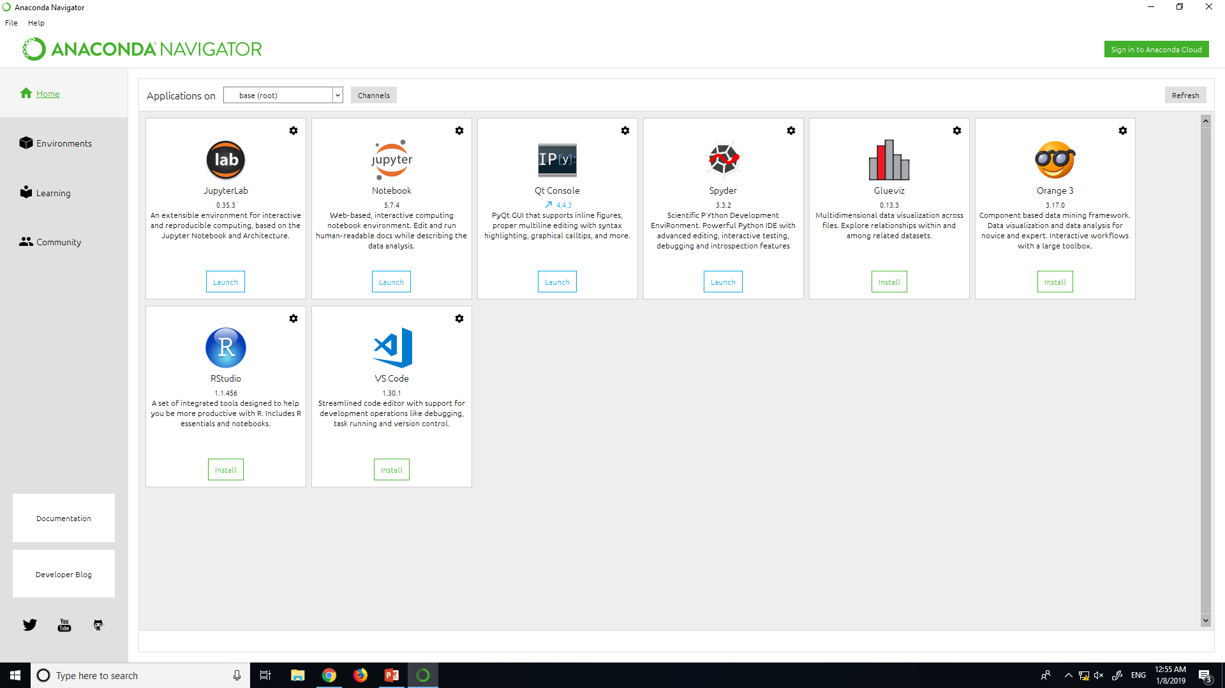
Find Jupyter
Click here

Slide 14
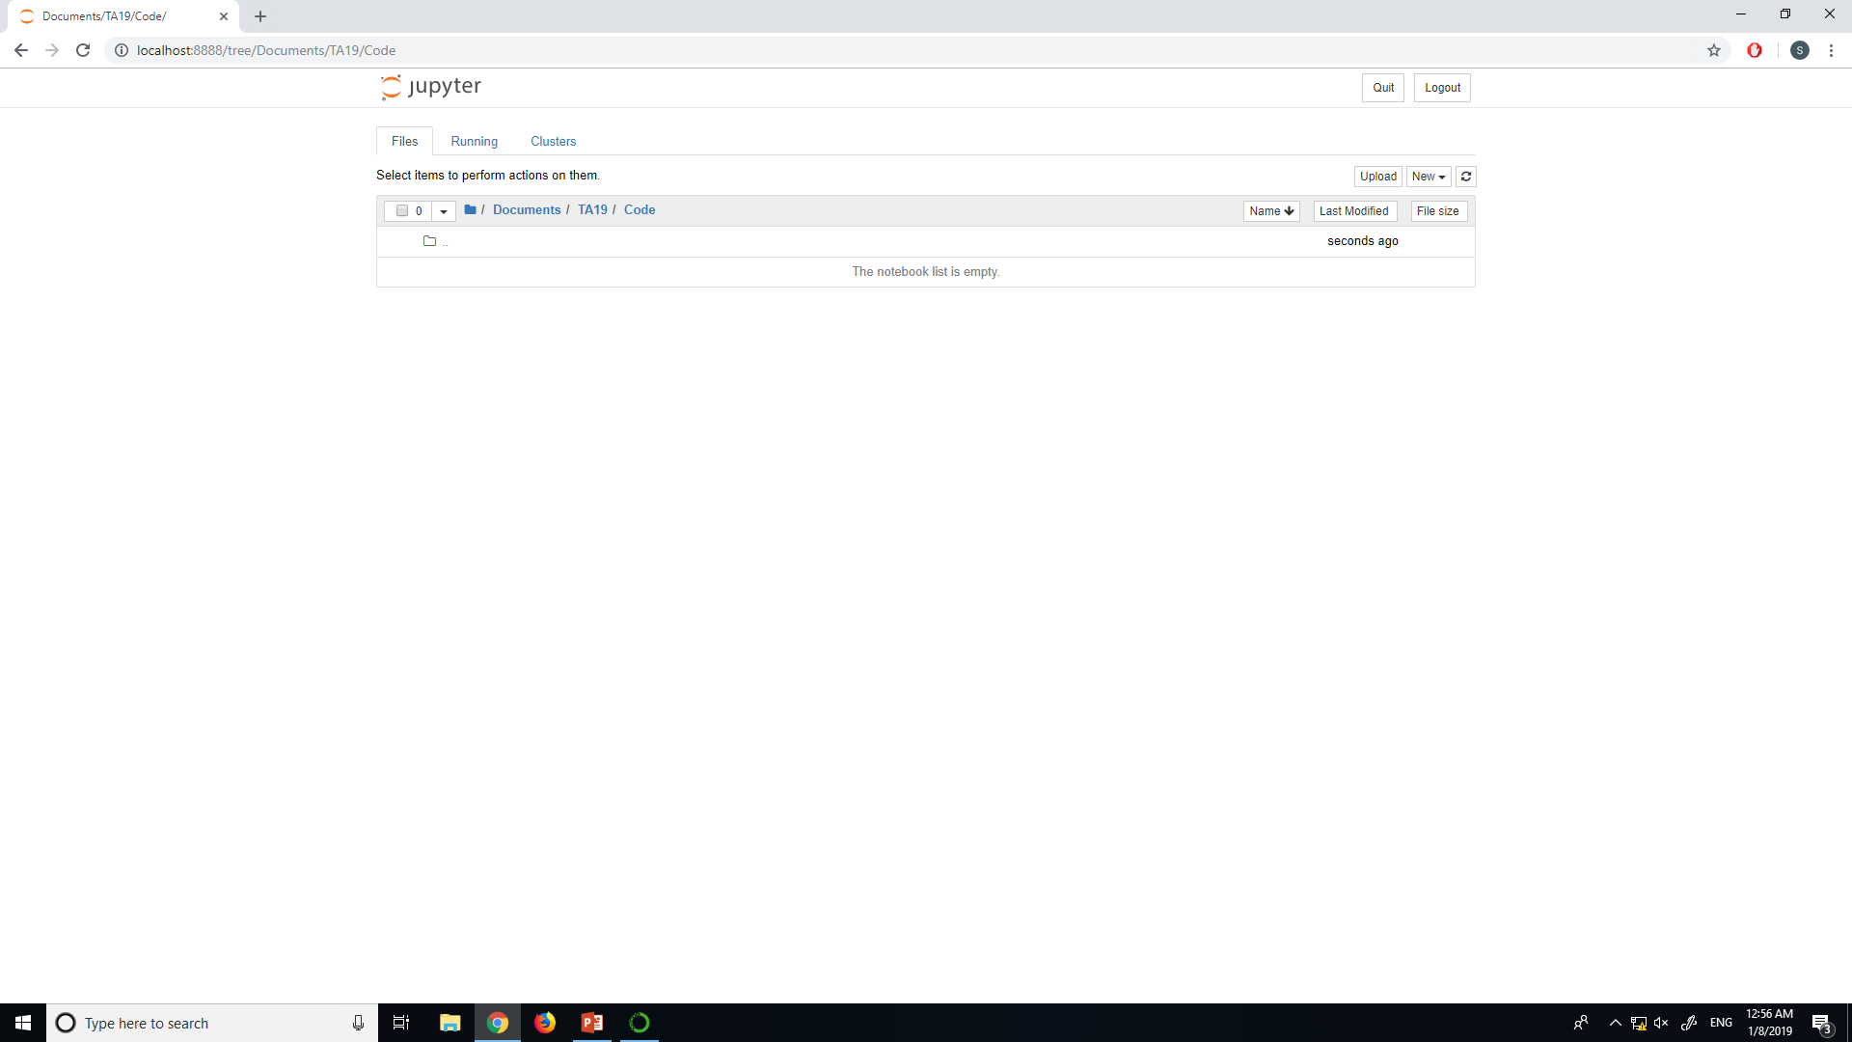
Navigate to Your Directory

Slide 15
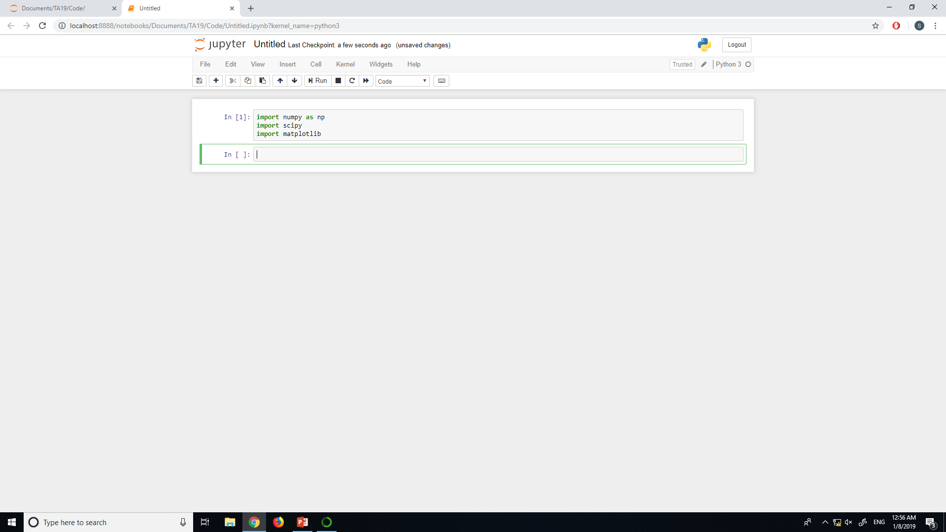
New > Python3 notebook

Slide 16
Discussion Section Objectives
Install Anaconda on your computer
Witness the power of matplotlib
Survey debugging tools for Jupyter
Grasp the importance of visualization

Slide 17
Discussion Section Objectives
Install Anaconda on your computer
Witness the power of matplotlib
Survey debugging tools for Jupyter
Grasp the importance of visualization

Slide 18
Urban Spatial Order: Street Network Orientation, Configuration, and Entropy
My favorite visualization paper

Slide 19
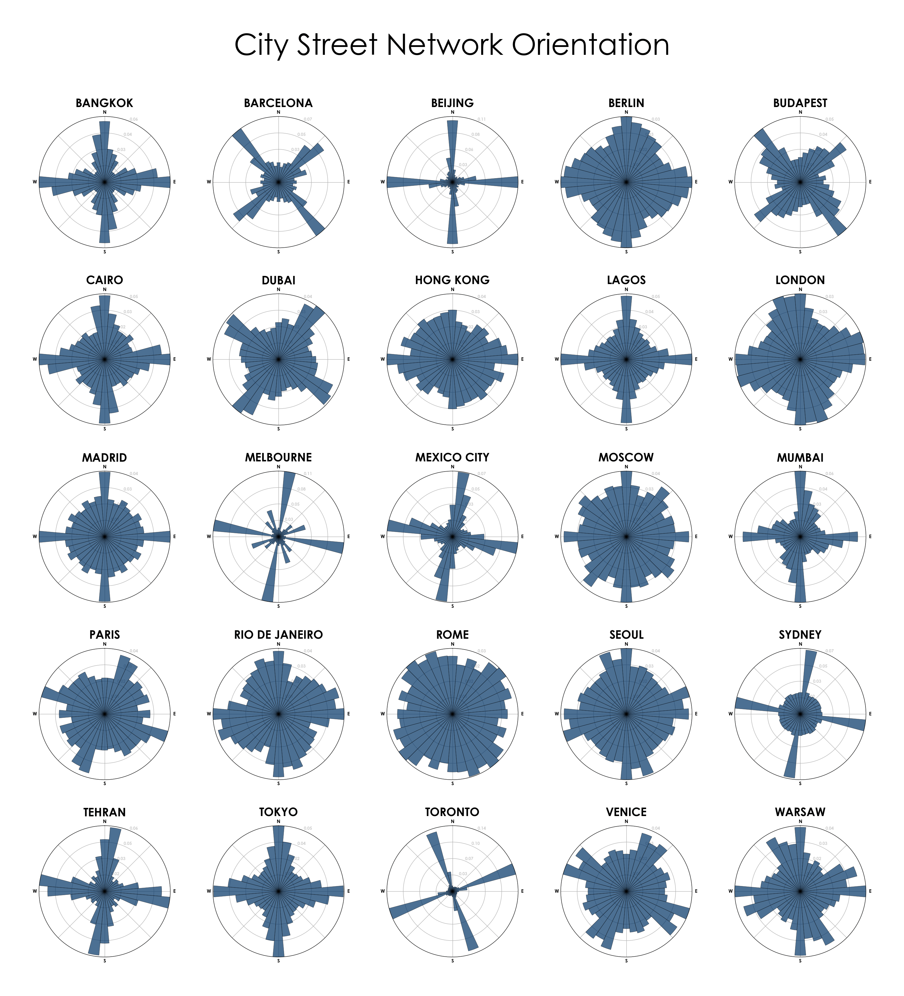

Slide 20
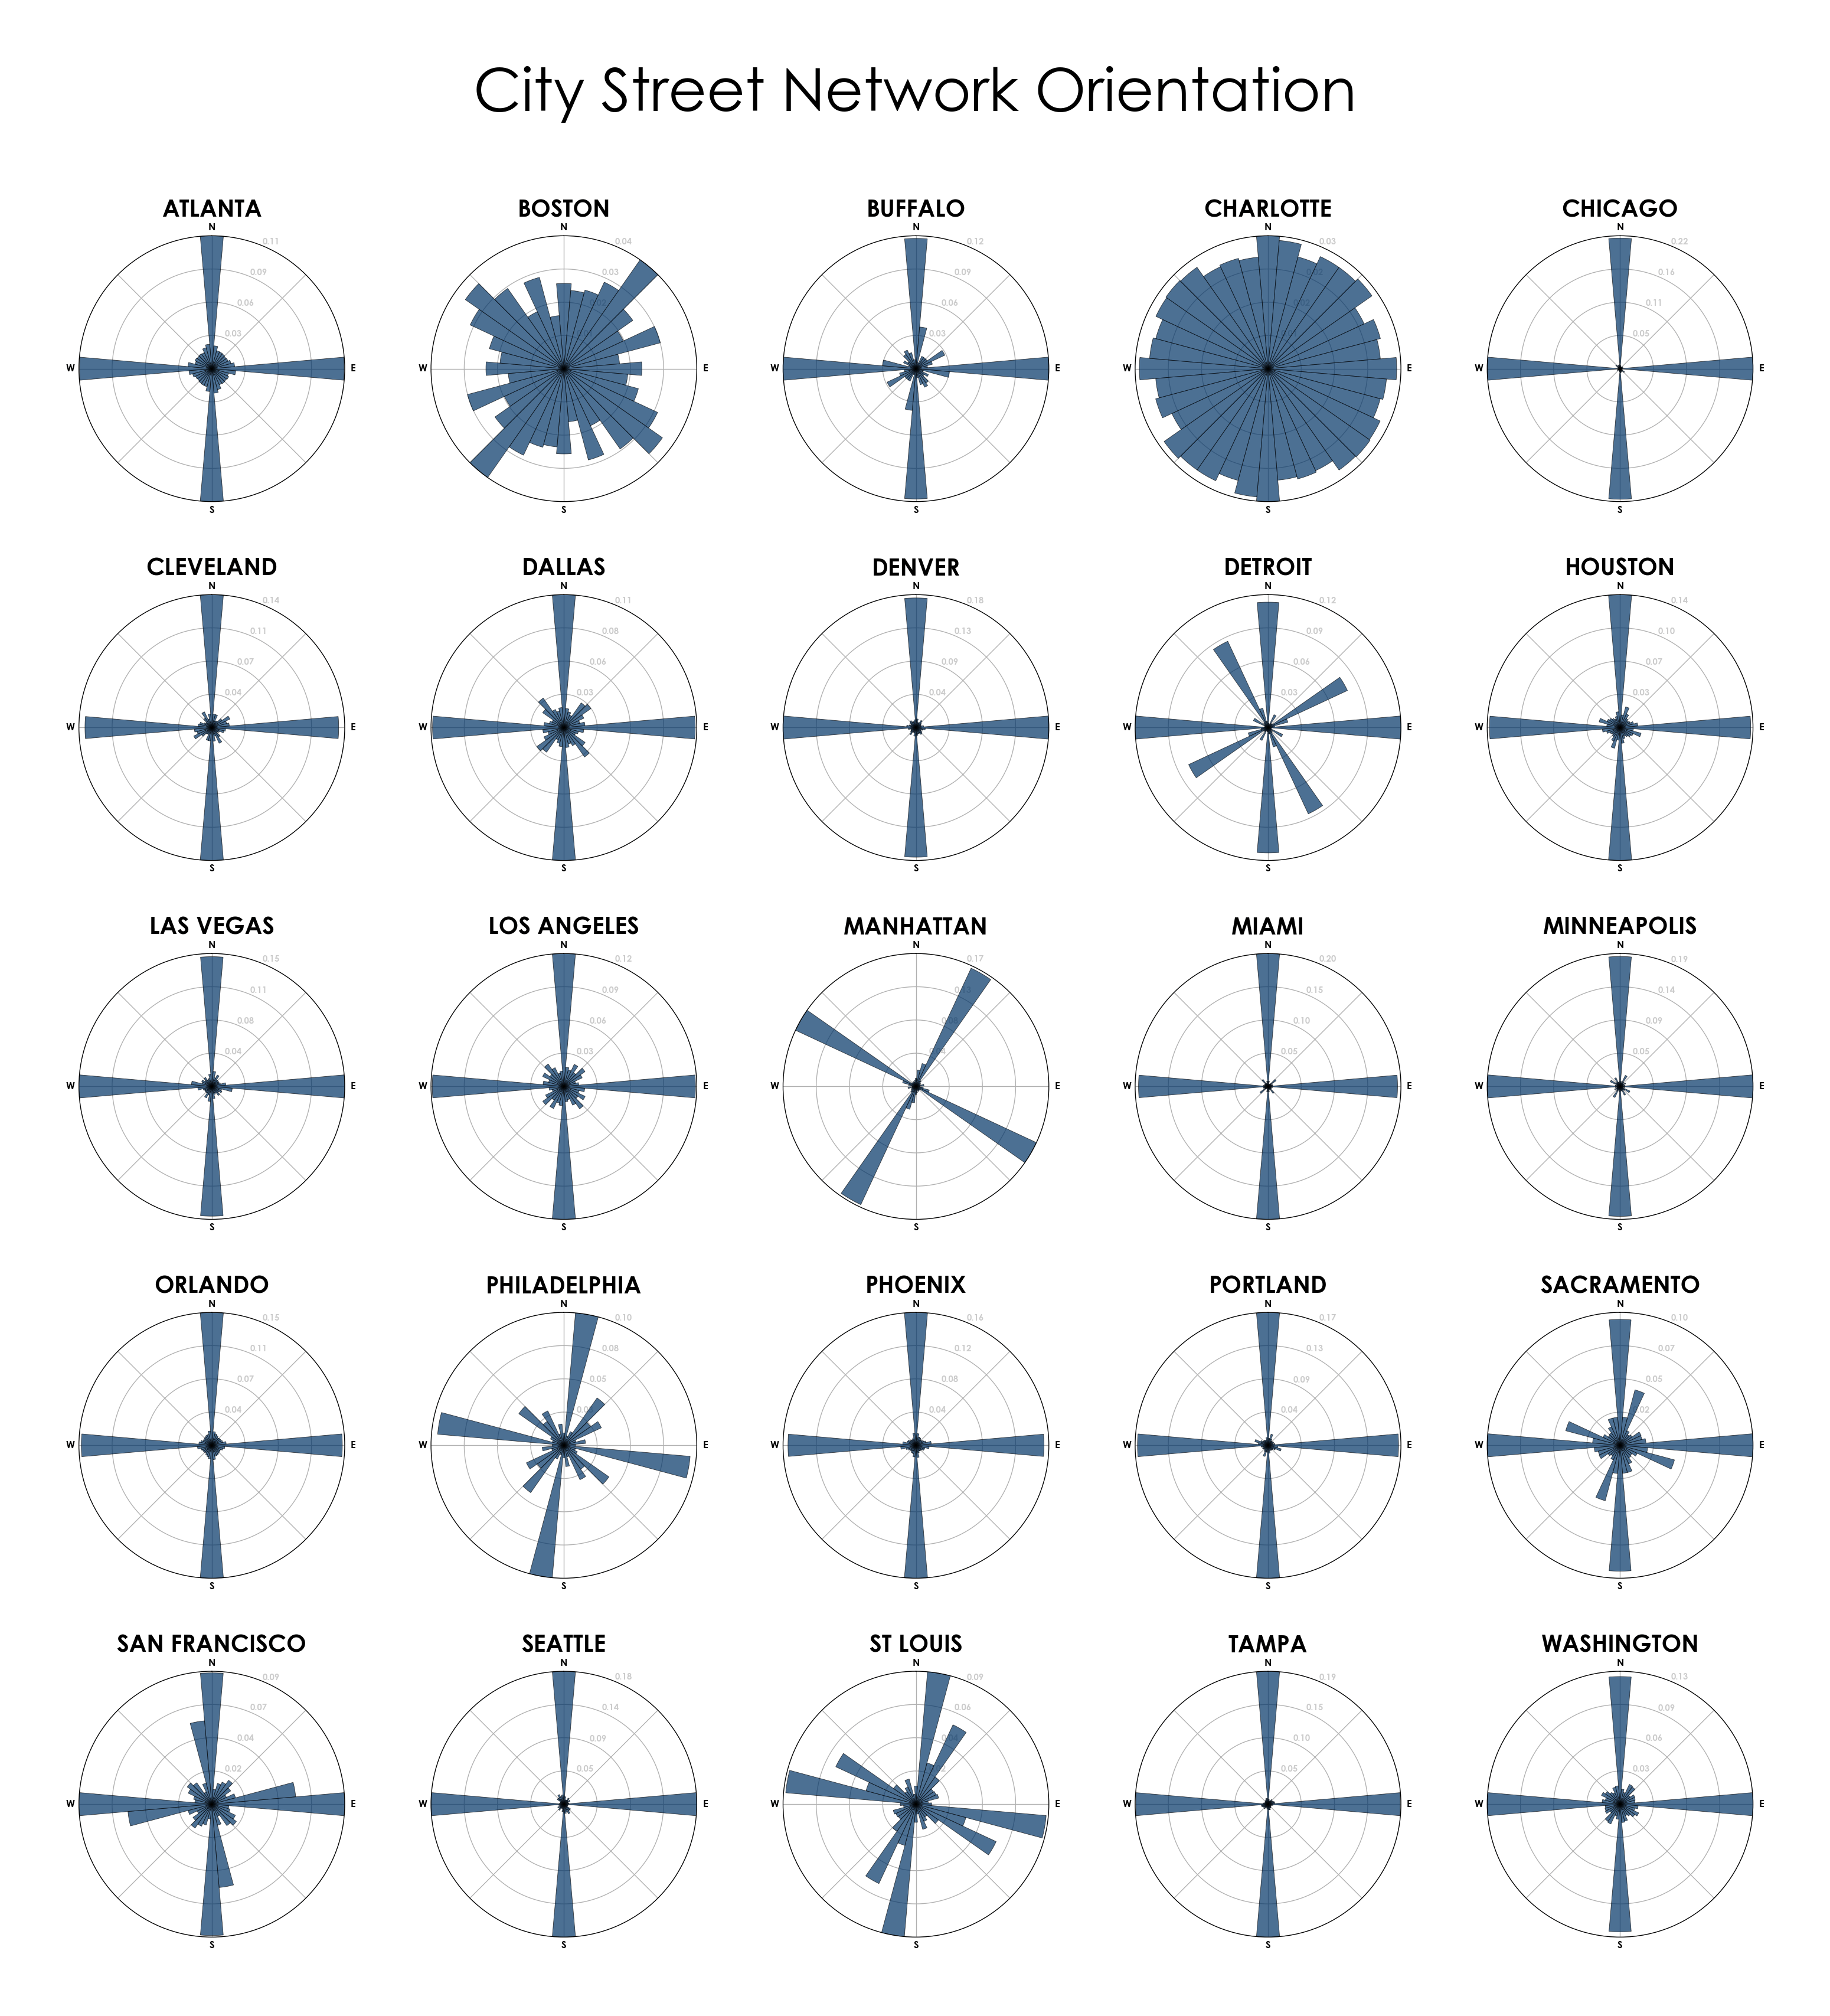

Slide 21
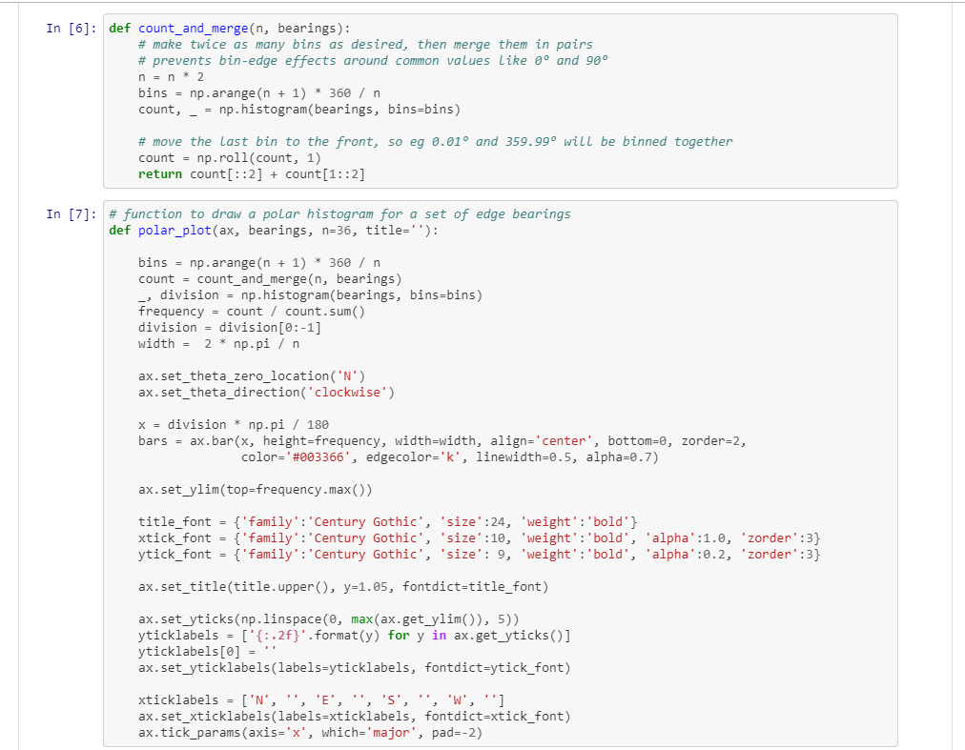
Just a Matplotlib Polar Plot
Store orientation counts in a numpy array
Make a polar plot, bar angles = street orientations
Full code available at,
https://github.com/gboeing/osmnx-examples/blob/master/notebooks/17-street-network-orientations.ipynb

Slide 22
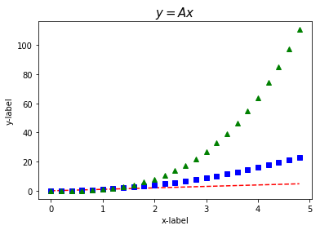
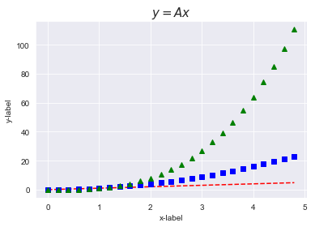
Matplotlib Styles

Slide 23
Simple Scripts

Slide 24
Discussion Section Objectives
Install Anaconda on your computer
Witness the power of matplotlib
Survey debugging tools for Jupyter
Grasp the importance of visualization

Slide 25
Discussion Section Objectives
Install Anaconda on your computer
Witness the power of matplotlib
Survey debugging tools for Jupyter
Grasp the importance of visualization

Slide 26
Jupyter is the Hacker’s Friend

Slide 27
Discussion Section Objectives
Install Anaconda on your computer
Witness the power of matplotlib
Survey debugging tools for Jupyter
Grasp the importance of visualization

Slide 28
Discussion Section Objectives
Install Anaconda on your computer
Witness the power of matplotlib
Survey debugging tools for Jupyter
Grasp the importance of visualization

Slide 29
Making Good Plots Helps Everyone

Slide 30
Discussion Section Objectives
Install Anaconda on your computer
Witness the power of matplotlib
Survey debugging tools for Jupyter
Grasp the importance of visualization

Slide 31
Discussion Section Objectives
Install Anaconda on your computer
Witness the power of matplotlib
Survey debugging tools for Jupyter
Grasp the importance of visualization

